Slide 1
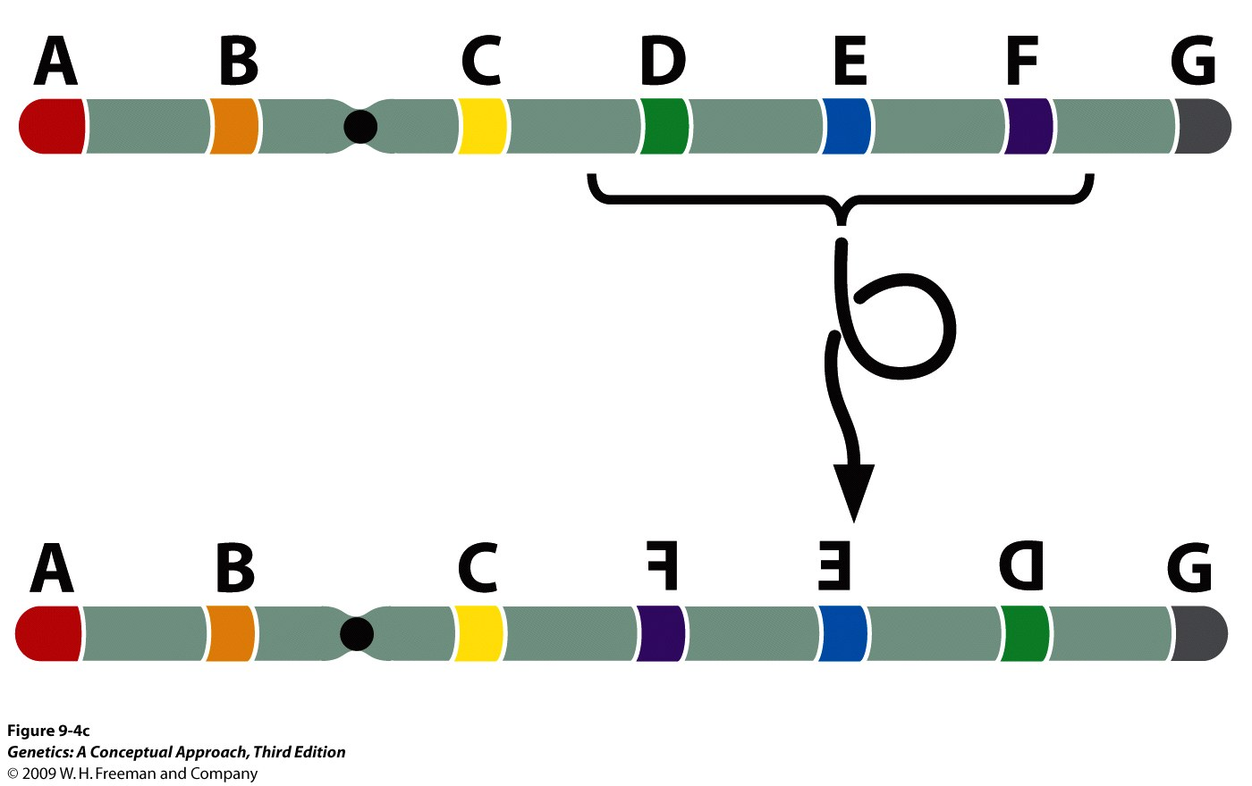
Inversion
A type of chromosomal aberration in which a segment of a chromosome is turned around 180° within a chromosome.
If the centromere is included in the inverted segment, it is called pericentric inversion. If the centromere is not part of rearranged segment, it is called paracentric inversion.
Inversion suppresses the recovery of crossover products.
Very interesting in genetic studies.

Slide 2
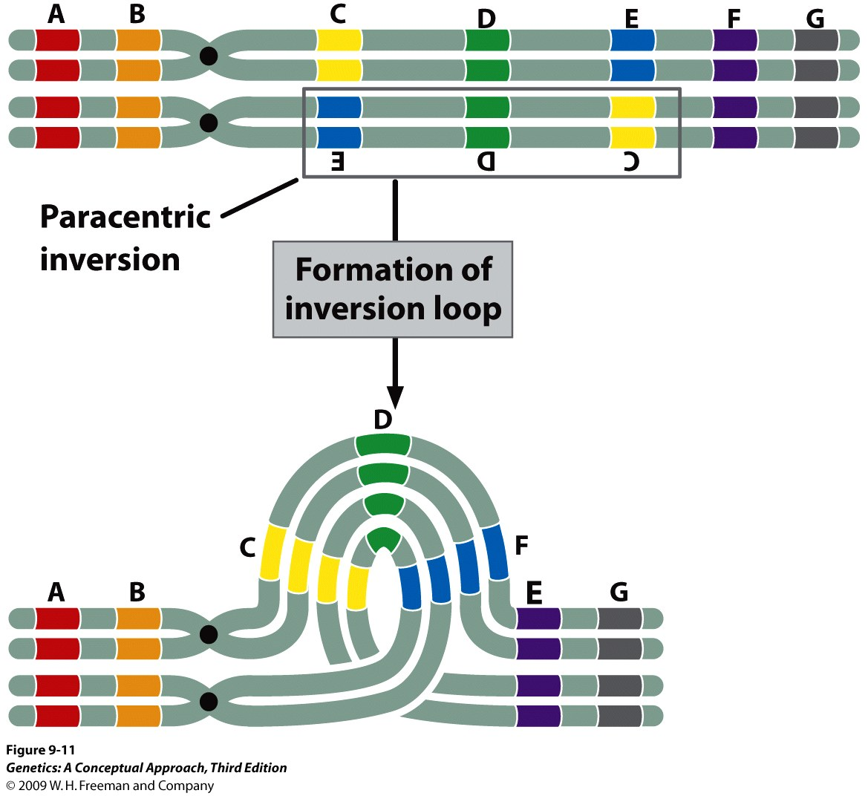
Paracentric Inversion
Genetic consequences of recombination within a paracentric inversion.

Slide 3
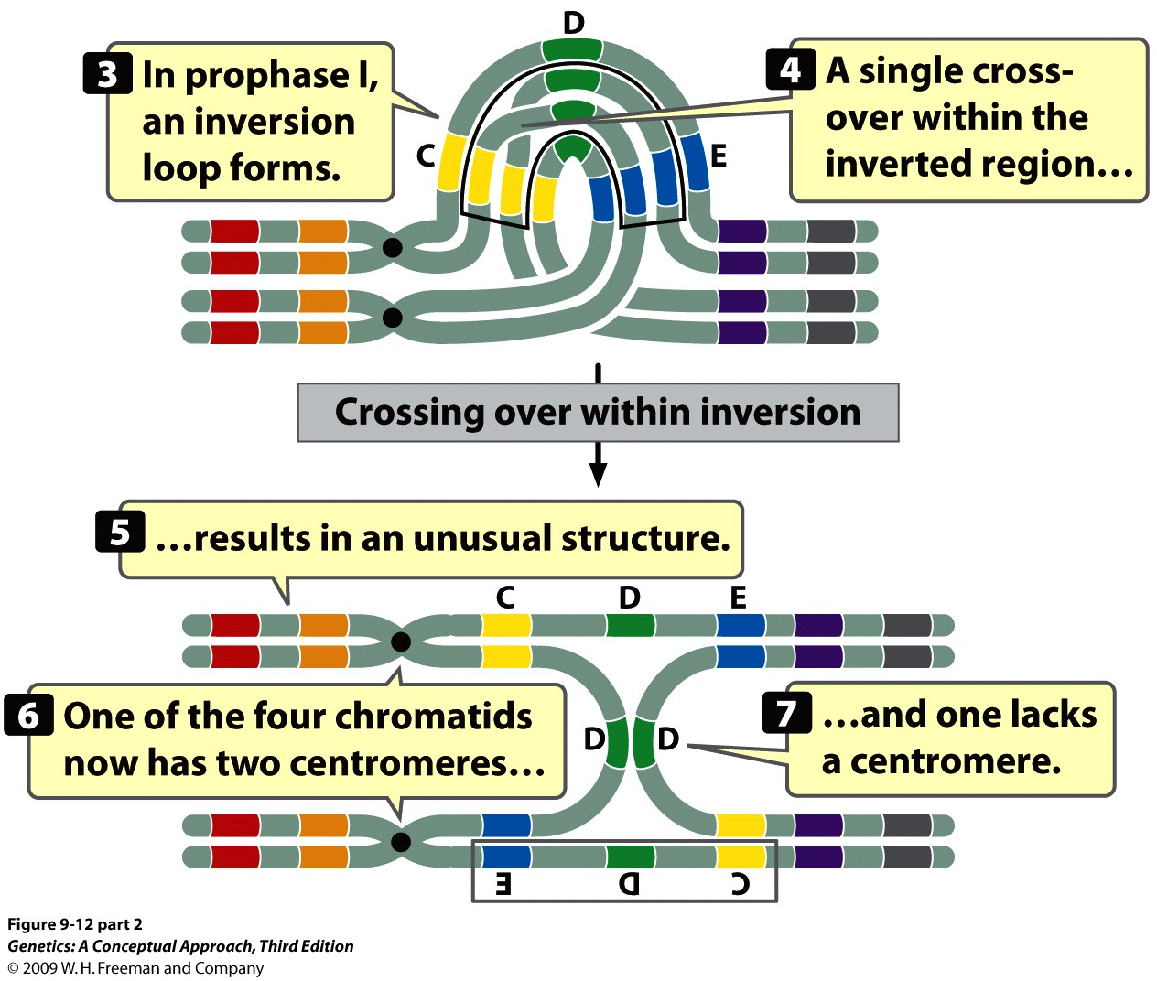
Notes:
9.12 (part 2) In a heterozygous individual, a single crossover within a paracentric inversion leads to abnormal gametes.

Slide 4
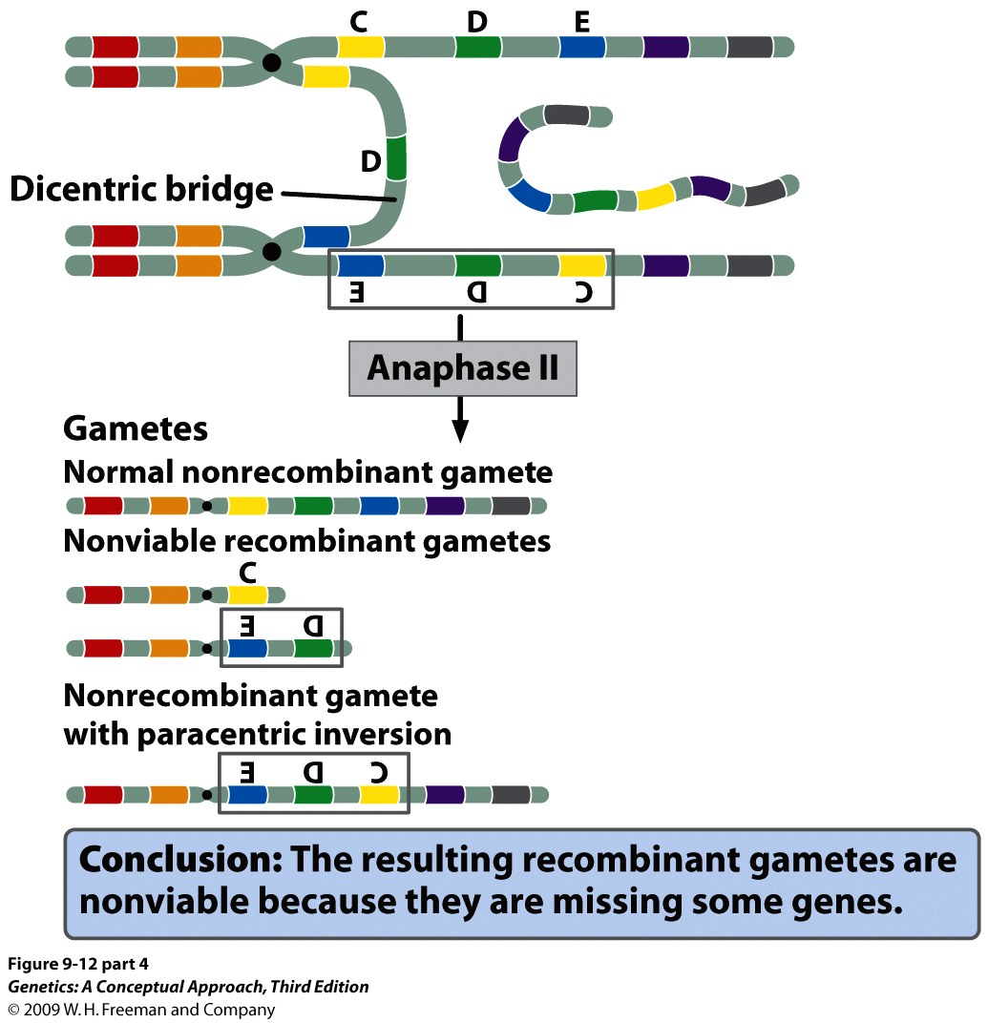
Notes:
9.12 (part 4) In a heterozygous individual, a single crossover within a paracentric inversion leads to abnormal gametes.

Slide 5
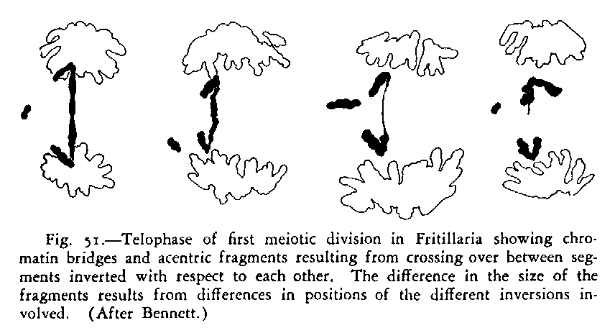
Proof that single crossovers do occur within an inversion
1. Chromosome bridges can be seen in meiotic spreads

Slide 6
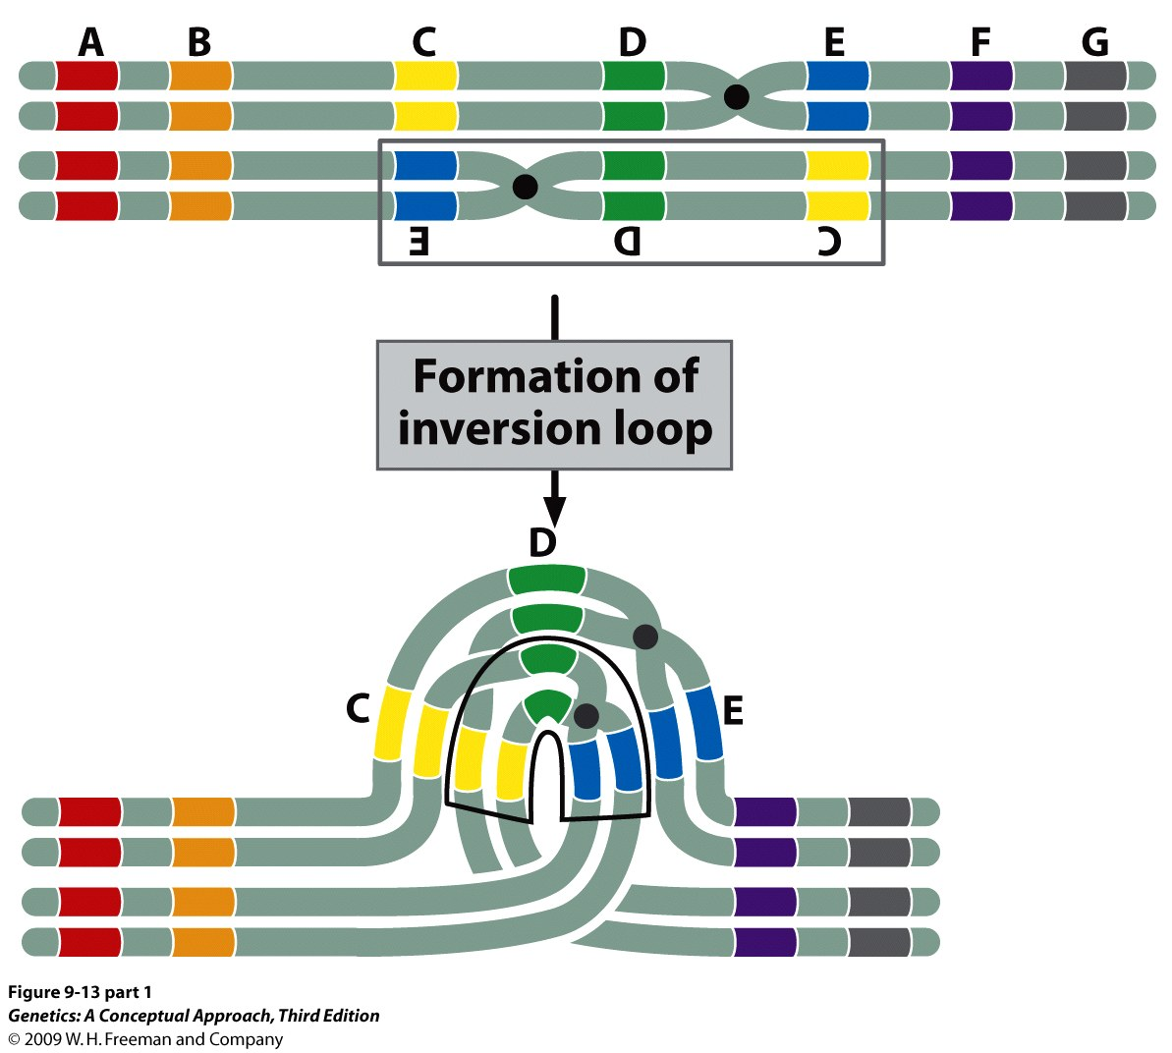
Pericentric Inversion
Genetic consequences of recombination within a pericentric inversion.

Slide 7
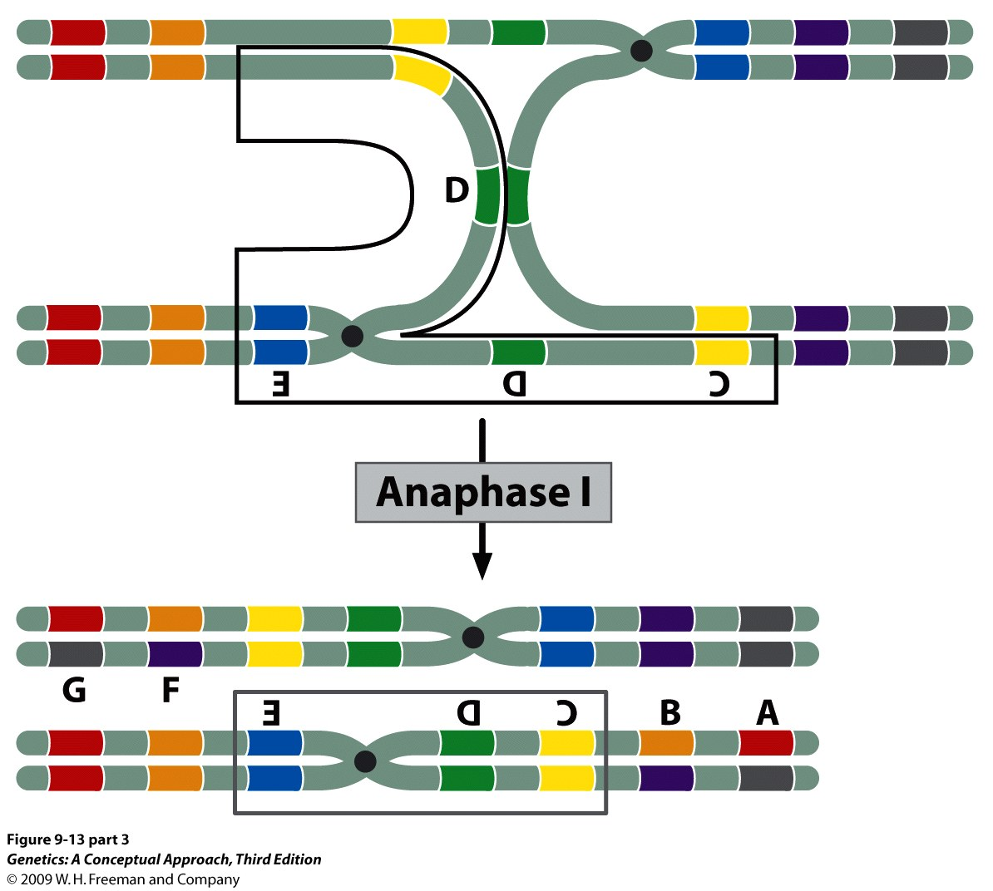
Notes:
9.13 (part 3) In a heterozygous individual, a single crossover within a pericentric inversion leads to abnormal gametes.

Slide 8
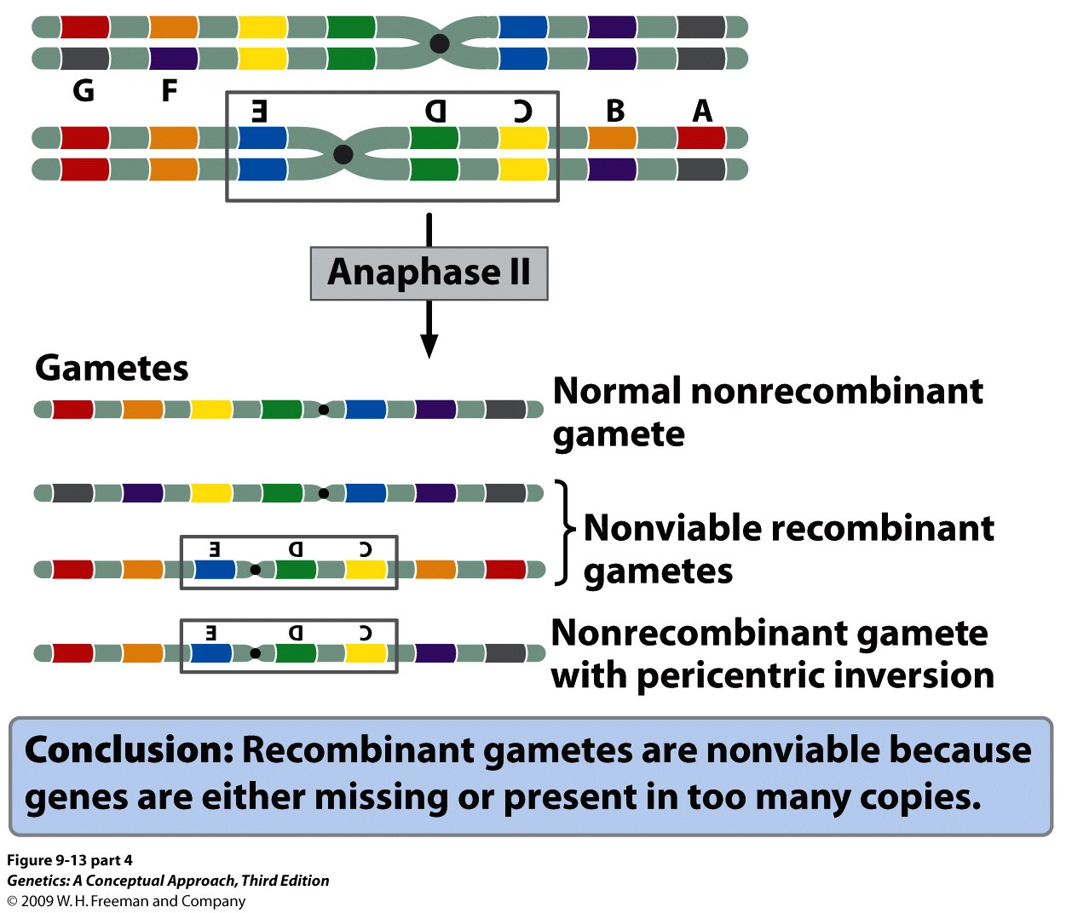
Notes:
9.13 (part 4) In a heterozygous individual, a single crossover within a pericentric inversion leads to abnormal gametes.

Slide 9
Balance lethals
H. Muller
l₁= a recessive lethal mutation
l₂= a different recessive lethal mutation
l₁
l₁
X
l₂
l₂
l₁
l₁
l₂
:
:
stock
l₁
l₂
l₂
1
2
1

Slide 10
Balancer Chromosome
H. Muller
Has a recessive lethal mutation.
Has inversions, lots of them
Carries a dominant marker to help identification.
l₁
l₁
X
Bal
Bal
l₁
l₁
Bal
:
:
stock
l₁
Bal
Bal
1
2
1

Slide 11
Translocation
The movement of a chromosomal segment to a new location in the genome.
In a nonreciprocal translocation, genetic material moves from one chromosome to another without any reciprocal exchange. A reciprocal translocation involves the exchange of segments between two nonhomologous chromosomes.
Alternate segregation vs adjacent segregation
Causes semisterility

Slide 12
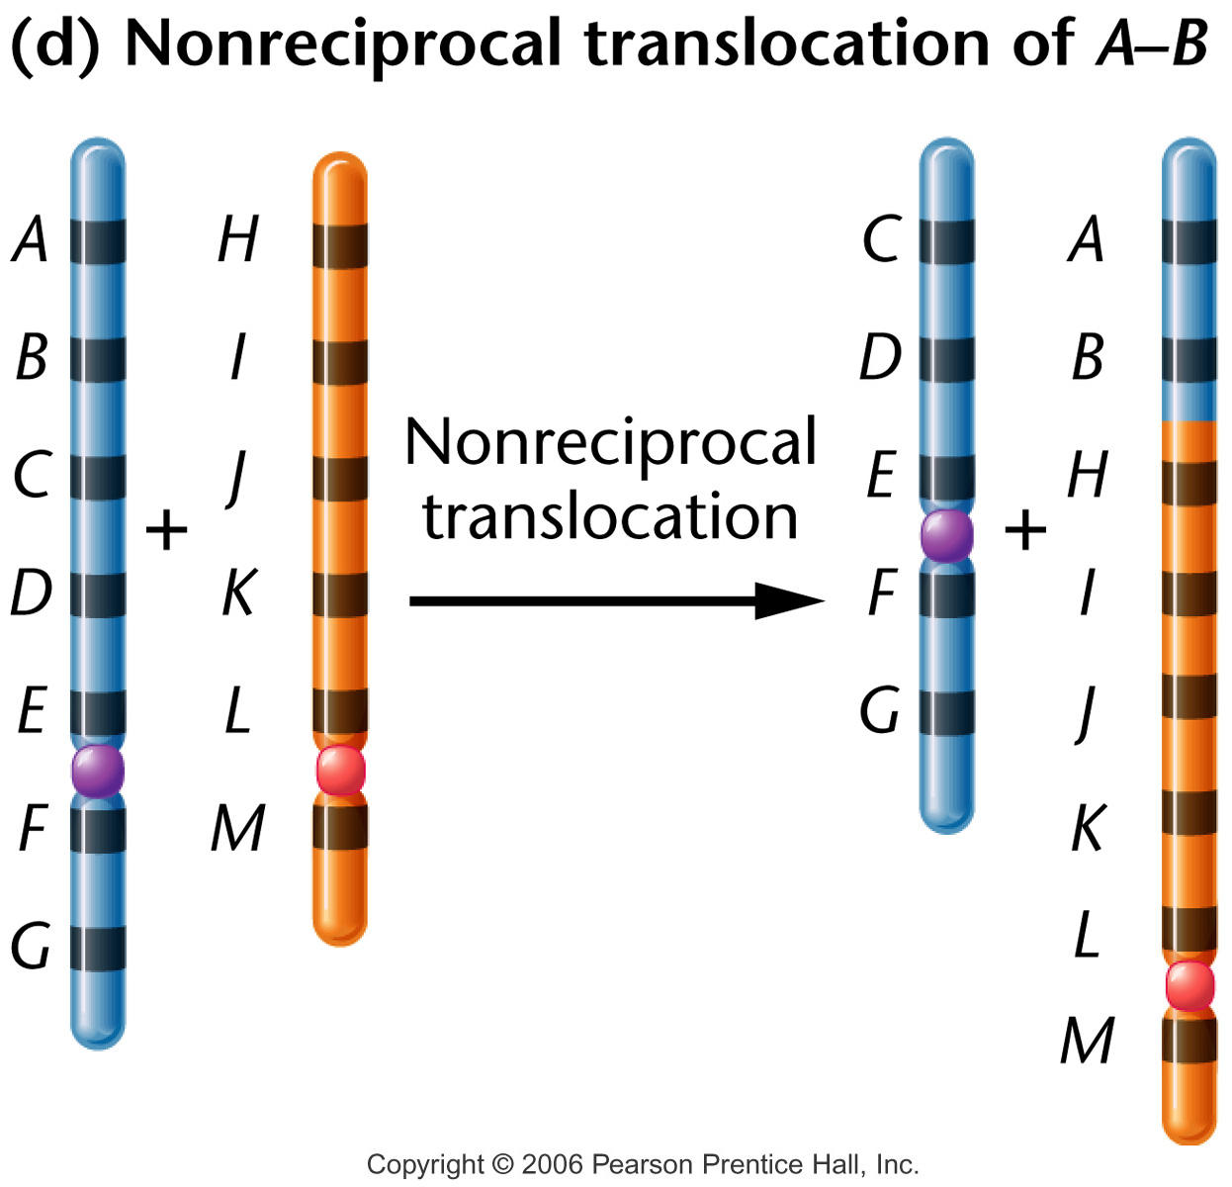
Notes:
Figure 8-14d Overview of the five different types of rearrangement of chromosome segments.

Slide 13
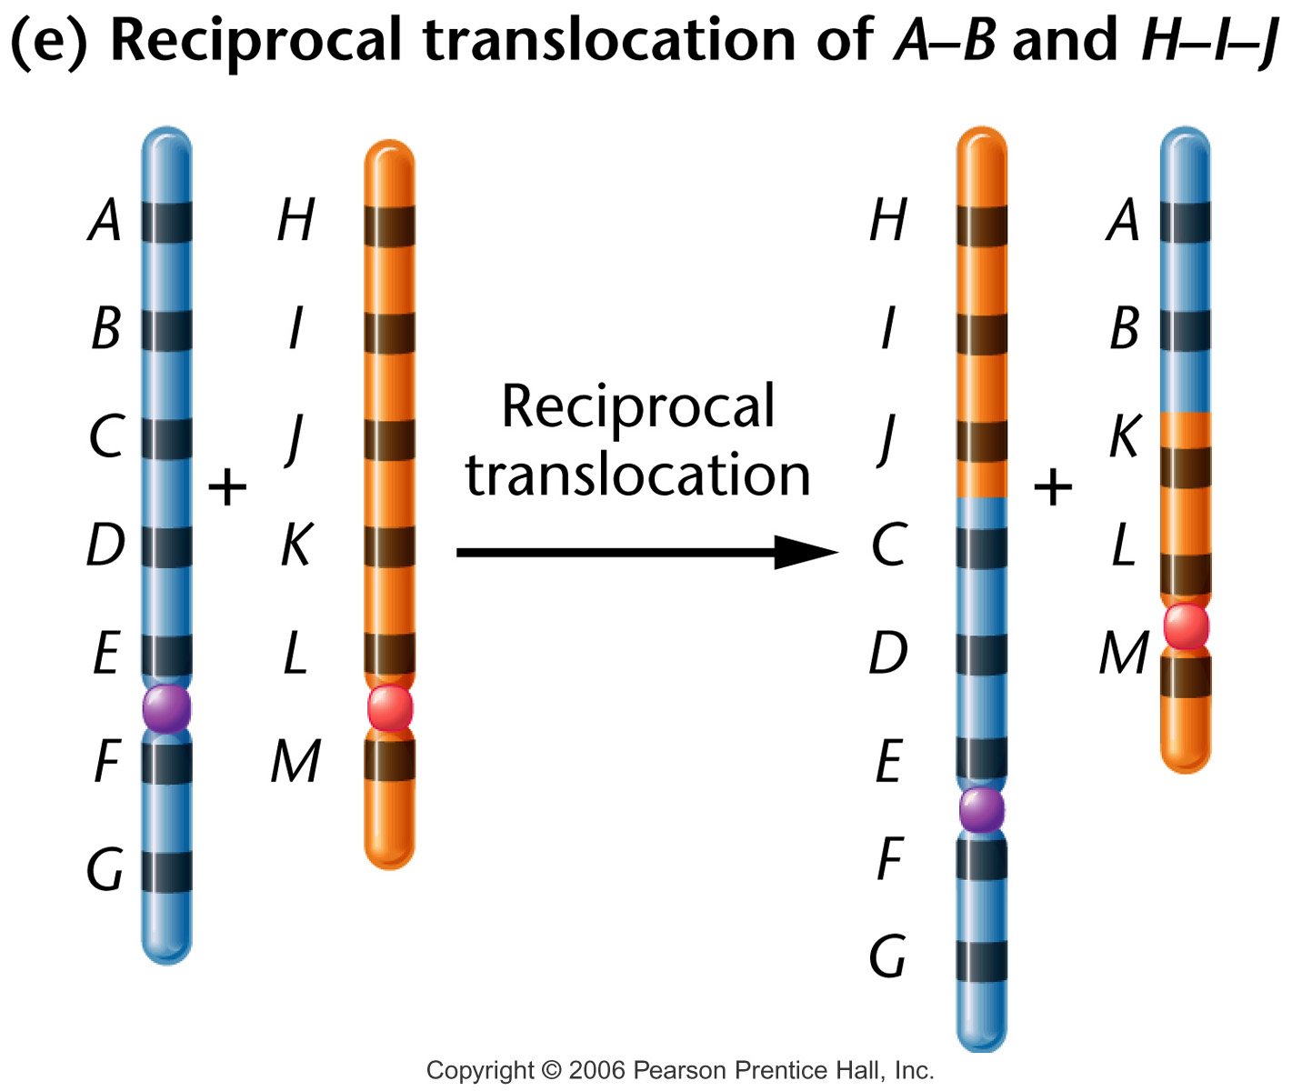
Place 08_14e.jpg here
Notes:
Figure 8-14e Overview of the five different types of rearrangement of chromosome segments.

Slide 14
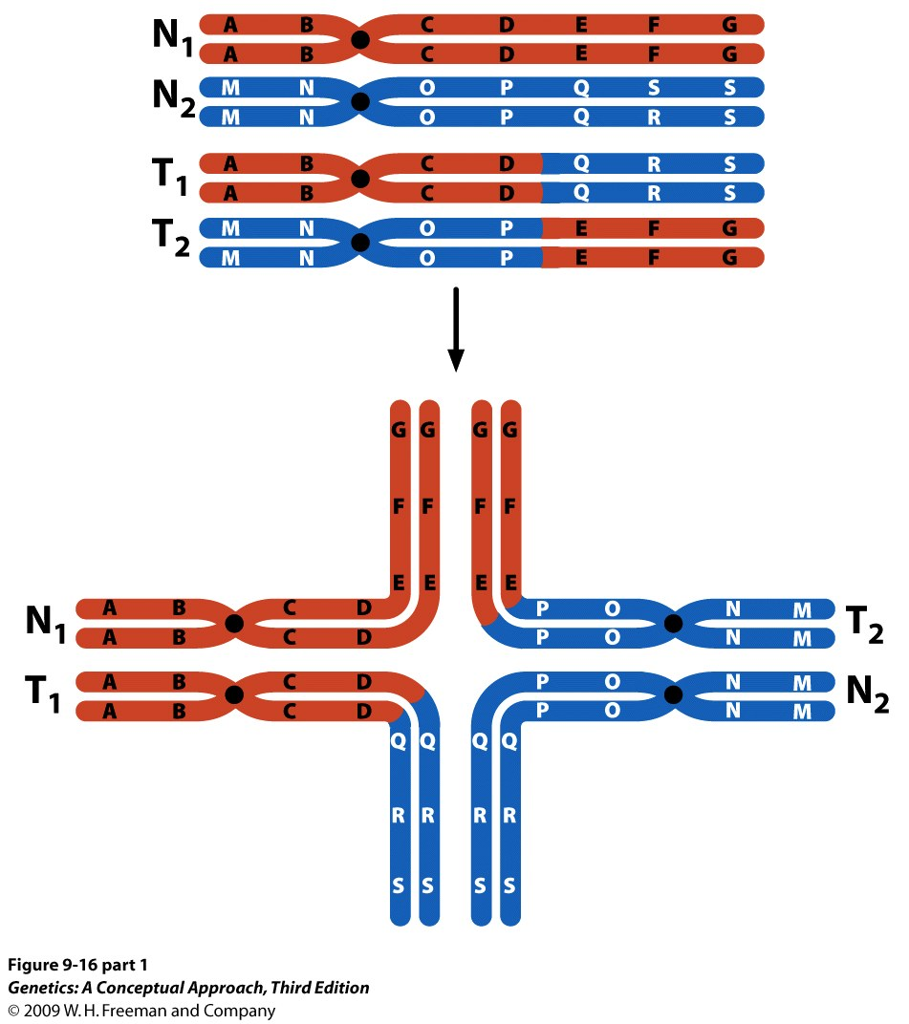
Notes:
9.16 (part 1) In an individual heterozygous for a reciprocal translocation, crosslike structures form in homologous pairing.

Slide 15
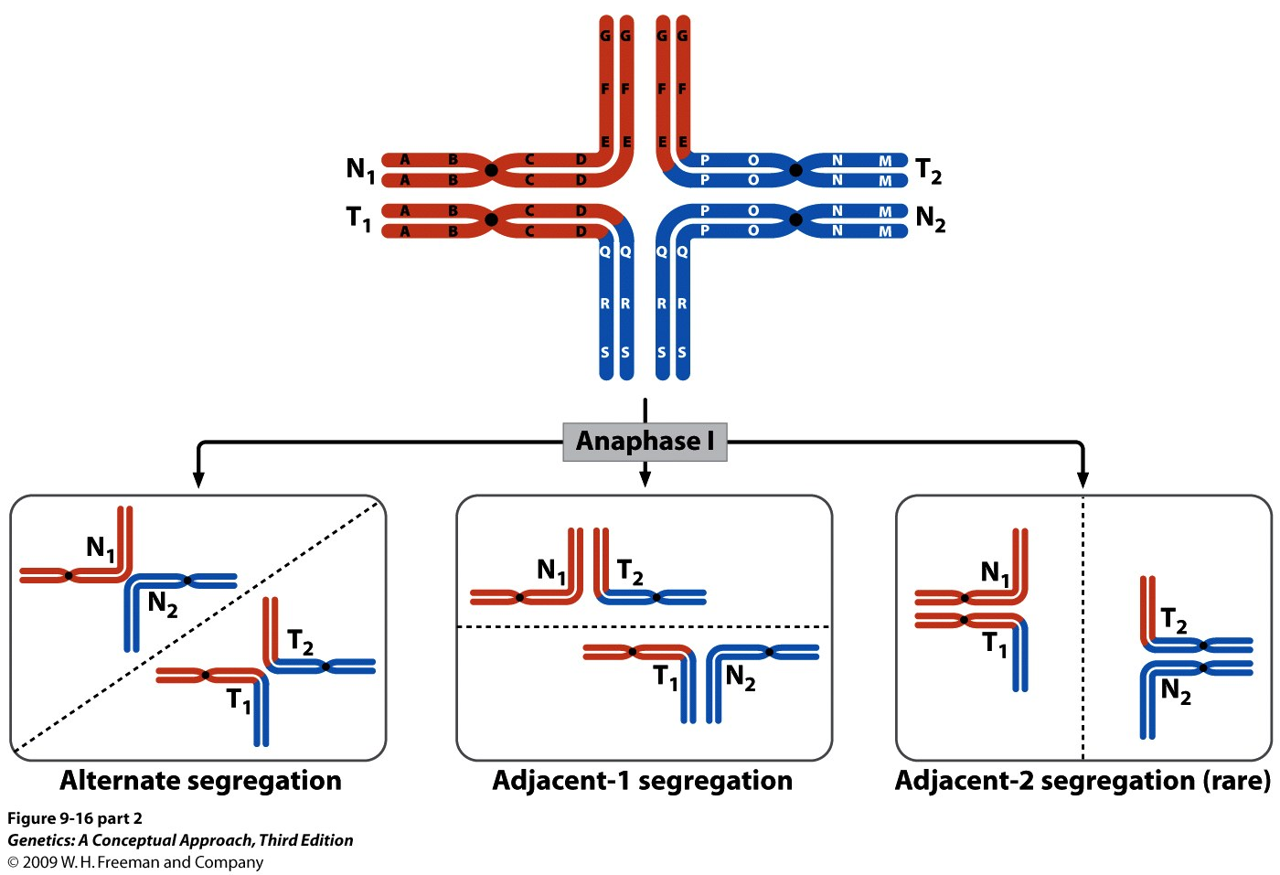
Notes:
9.16 (part 2) In an individual heterozygous for a reciprocal translocation, crosslike structures form in homologous pairing.

Slide 16
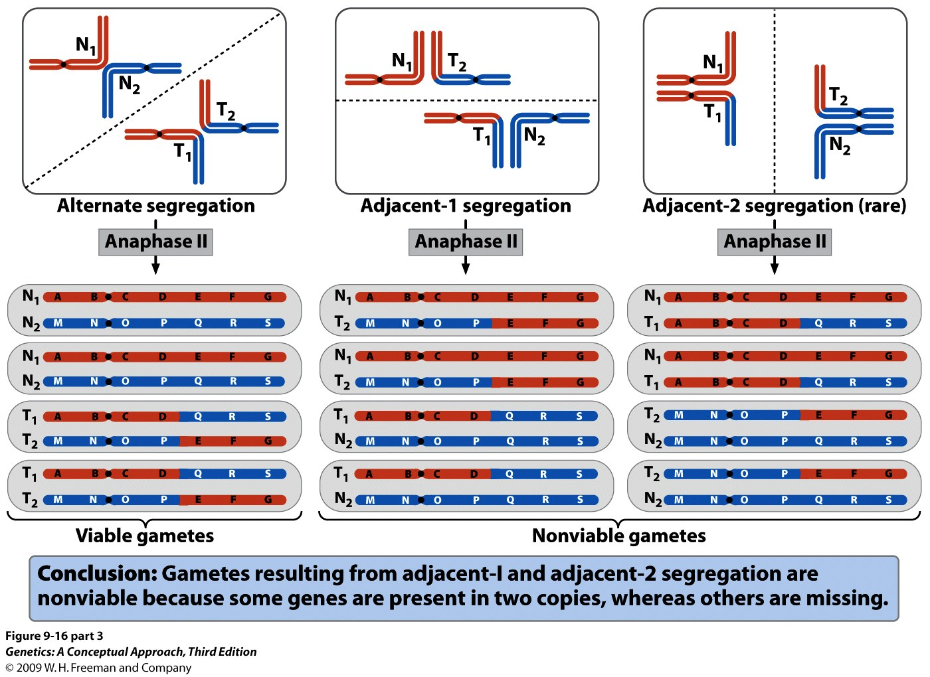
Notes:
9.16 (part 3) In an individual heterozygous for a reciprocal translocation, crosslike structures form in homologous pairing.

Slide 17
Robertsonian translocation (centric fusion)
Involves breaks a the extreme ends of the short arms of two nonhomologous acrocentric chromosomes.
The small acentric fragments are lost and the larger chromosomal segments fuse at their centromeric region, producing a new larger submetacentric or metacentric chromosome.
These are the most common types of chromosome rearrangement in humans.
Familial Down syndrome

Slide 18
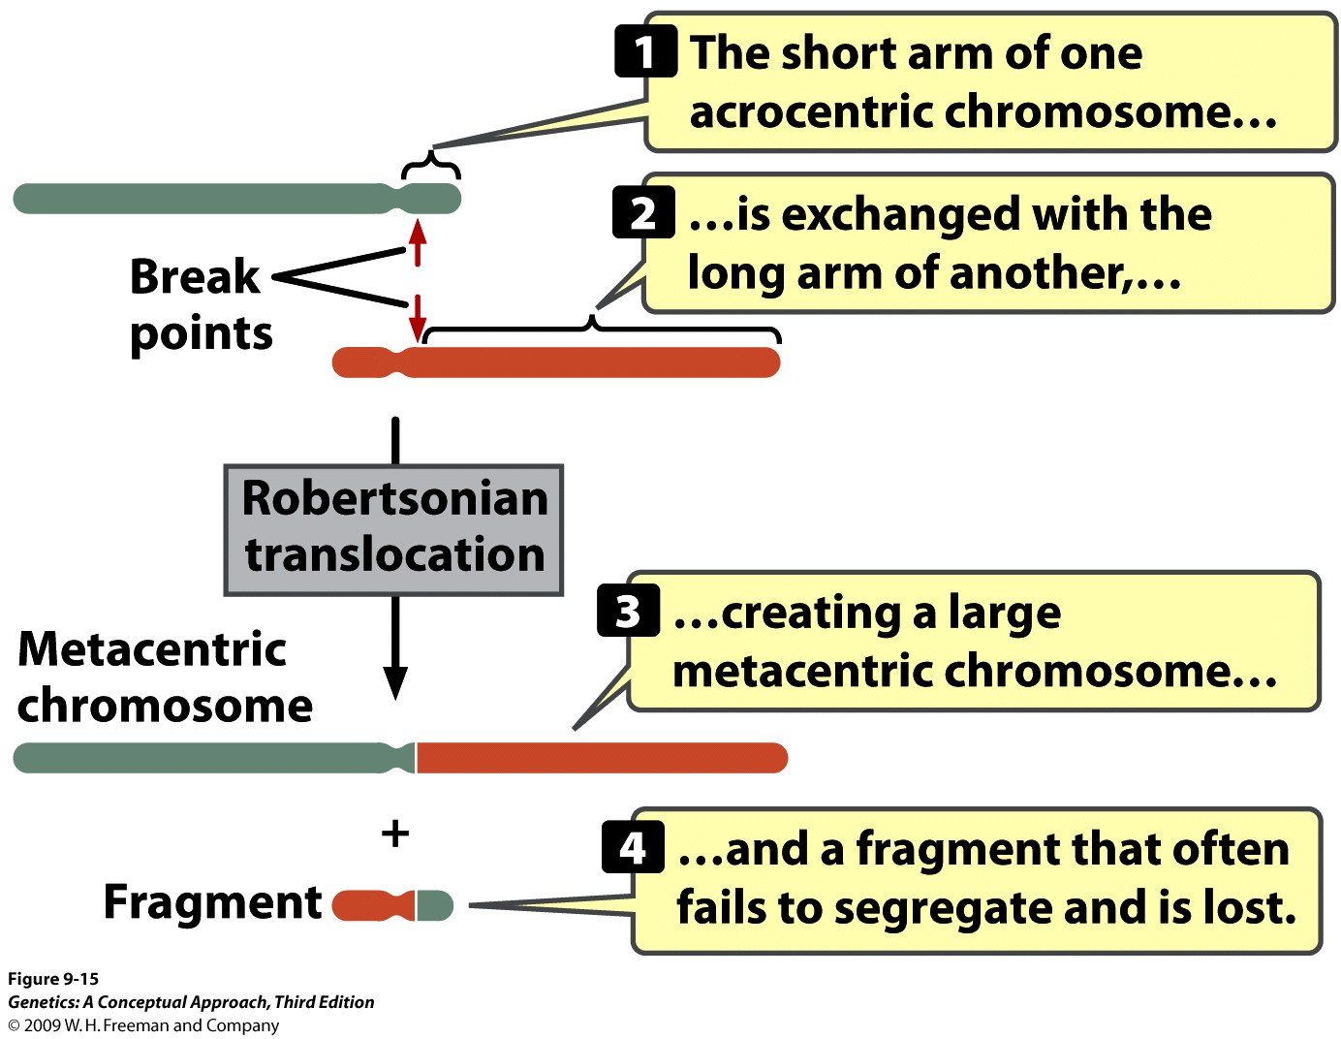
Notes:
9.15 In a Robertsonian translocation, the short arm of one acrocentric chromosome is exchanged with the long arm of another.

Slide 19
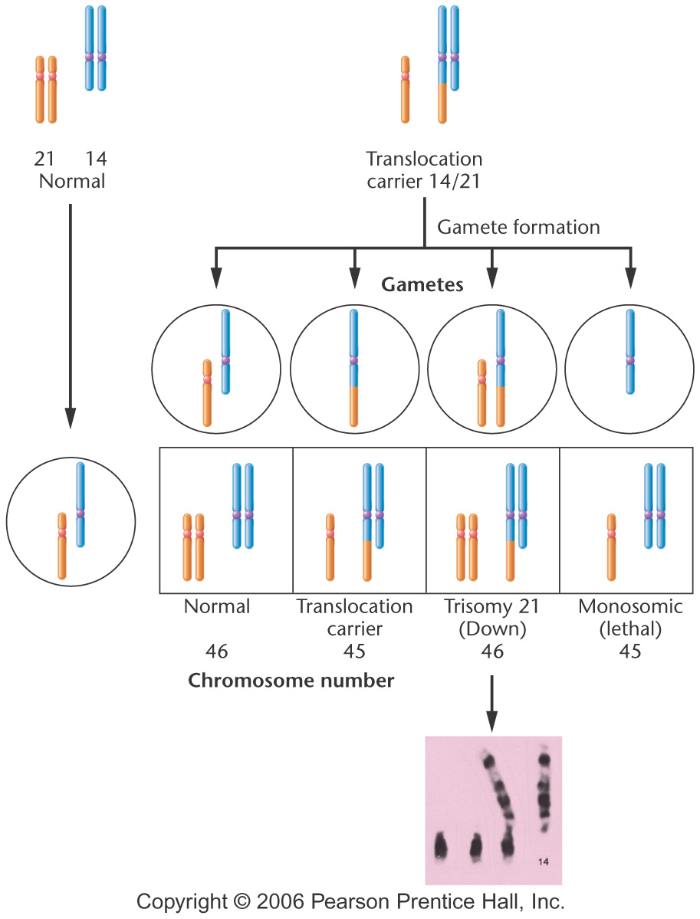
Familial Down syndrome
Notes:
Figure 8-25 Chromosomal involvement in familial Down syndrome. The photograph illustrates the relevant chromosomes from a trisomy 21 offspring produced by a translocation carrier parent.

Slide 20
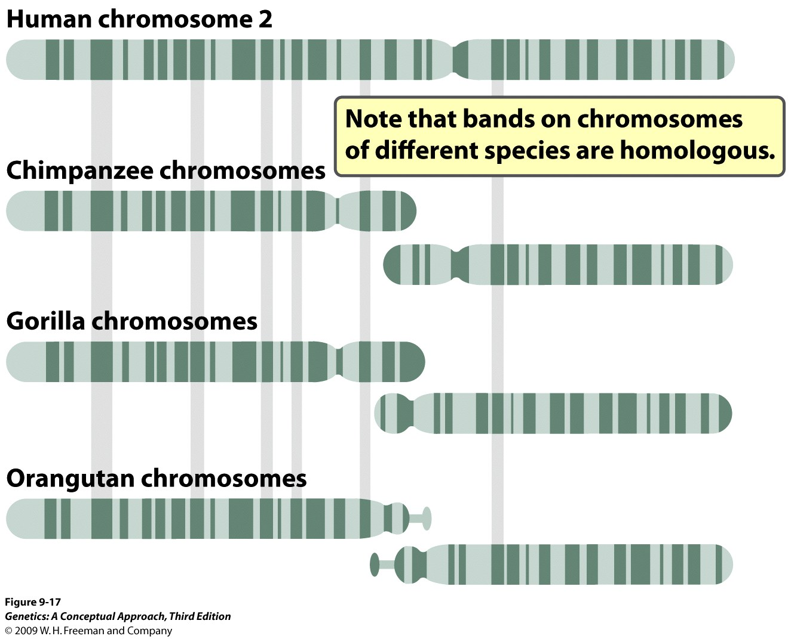
Notes:
9.17 Human chromosome 2 contains a Robertsonian translocation that is not present in chimpanzees, gorillas, or orangutans. G-banding reveals that a Robertsonian translocation in a human ancestor switched the long and short arms of the two acrocentric chromosomes that are still found in the other three primates. This translocation created the large metacentric human chromosome 2.

Slide 21
Chronic Myelogenous Leukemia
About 90% of patients with chronic myelogenous leukemia have a reciprocal translocation between long arm of chromosome 22 and the tip of the long arm of chromosome 9.
This translocation produces BCR-ABL, which is more active than the normal ABL gene.
The fusion protein stimulates increased, unregulated cell division, eventually leads to leukemia.

Slide 22
